Slide 1
Chapter-8
Measurement of Variables
Topics Discussed
OPERATIONAL DEFINITION
Dimensions and Elements of Concepts
What an Operational Definition is not
THE FOUR TYPES OF SCALE
Nominal
Ordinal
Interval
Ratio
INTERNATIONAL DEIMENSIONS OF OPERATIONAL DEFINITION AND SCALING

Slide 2
OPERATIONAL DEFINITION
There are at least two types of variables: One lends itself to objective and precise measurement; the other is more nebulous and does not lend itself to accurate measurement because of its subjective nature. However, despite the lack of physical measuring devices to measure the latter type, thee are ways of tapping the subjective feelings and perceptions of individuals. One technique is to reduce the abstract emotions or concepts such as motivation, involvement, satisfaction, buyer behaviour, stock market exuberance, and the like, to observable behaviour and characteristics.
OPERATIONAL DEFINITION: DIMENSIONS AND ELEMENTS
Operationalizing, or operationally defining a concept to render it measurable, is done by looking at the behavioral dimensions, facets, or properties denoted by the concept. These are then translated into observable and measurable elements so as to develop an index of measurement of the concept. Operationally defining a concept involves a series of steps. An example will help to illustrate how this is done.

Slide 3
OPERATIONAL DEFINITION (contd..)
Example :
OPERATIONALIZING THE CONCEPT OF ACHIEVEMENT MOTIVATION
While Operationalizing achievement motivation there are five typical broad characteristics which are called dimensions. Each dimension is further broken down into its elements which are somehow quantitatively measurable

Slide 4
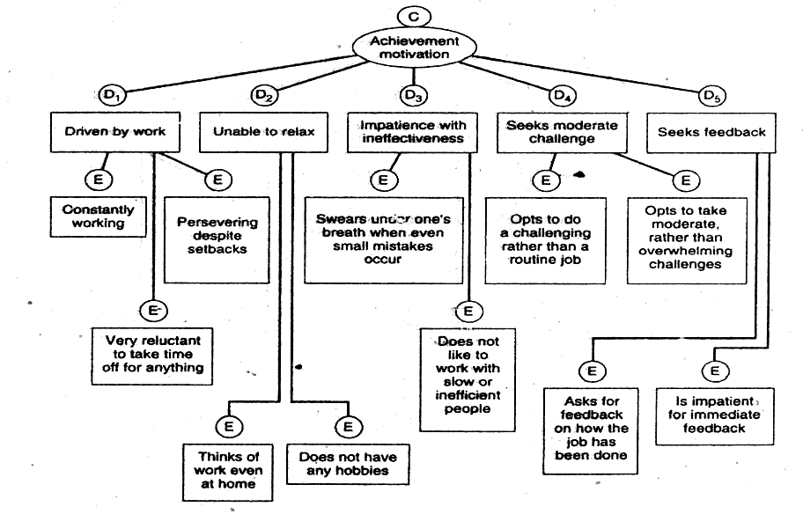
Dimensions (D) and elements (E) of the concept (C) achievement motivation

Slide 5
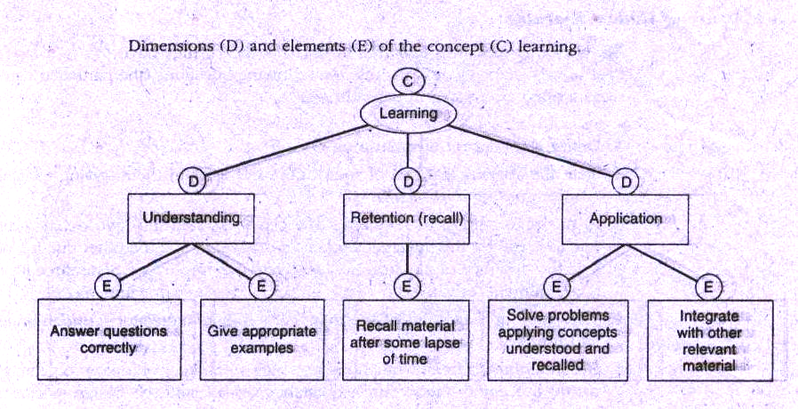
Example 2: Operationalizing the concept of learning

Slide 6
OPERATIONAL DEFINITION (contd..)
What an Operational Definition is not
An operational definition does not describe the correlates of the concept. For example success in performance can not be a dimension of achievement motivation, even though a motivated person is likely to meet with it in large measure.
Thus achievement motivation and performance and/or success may be highly correlated but we can not measure an individual’s level of motivation through success and performance. Thus it is clear that operationally defining a concept does not consist of delineating the reasons, antecedents, consequences or correlates of the concept. Rather it describes its observable characteristics in order to be able to measure the concept.

Slide 7
Scales
A scale is a tool or mechanism by which individuals are distinguished as to how they differ from one another on the variables. The scale or tool could be a gross one in the sense that it would only broadly categorize individuals on certain variables or it could be a fine tuned tool that would differentiate individuals on the variables with variant degrees of sophistication.
There are four basic types of scales:
Nominal
Ordinal
Interval
Ratio
The degree of sophistication to which the scales are fine tuned increases progressively as we move from the nominal to ration scale.

Slide 8
Scales (contd..)
Nominal Scale
A nominal scale is one that allows the researcher to assign subjects to certain categories or groups e.g. with respect to the variable of gender respondents can be grouped into two categories-male and female. These two groups can be assigned code numbers 1 & 2. These numbers serve as simple and convenient category labels with no intrinsic value other than to assign respondents to one of two non-overlapping or mutually exclusive categories. Note that the categories are also collectively exhaustive. In other words there is no third category into which respondents would normally fall. Thus nominal scales categorize individuals or objects into mutually exclusive and collectively exhaustive groups.
Example:
American Japanese
Australian Polish
Chinese Russian
Other
Note that every respondent has to fit into one of the above seven categories and that the scale will allow computation of the numbers and percentage of respondents that fit into them

Slide 9
Scales (contd..)
Ordinal Scale
An ordinal scale not only categorizes the variables in such a way as to denote differences among the various categories, it also rank orders the categories in some meaningful way. With any variable for which the categories are to be ordered according to some preference, the ordinal scale would be used. The preference would be ranked (e.g. from best to worst; first to last) and numbered 1,2 and so on.
Example
Rank the following five characteristics in a job in terms of how important they are for you. You should tank the most important item as 1, the next in importance as 2 and so on, until you have ranked each of them 1,2,3,4 or 5
Job Characteristic Ranking of Importance
The opportunity provided by the job to:
1 Interact with others -
2 Use a number of different skills. -
3 Complete a whole task from beginning to end -
4 Serve others -
5 Work independently -

Slide 10
Scales (contd..)
Interval Scale
An interval scale allows us to perform certain arithmetical operation on data collected from respondents. Whereas the nominal scale allows us only to qualitatively distinguish groups by categorizing them into mutually exclusive and collectively exhaustive sets, and the ordinal scale to rank-order the preferences, the interval scale lets us measure the distance between any two points on the scale. This helps us to compute the Means and Standard Deviations of the responses on the variables. In other words the interval scale not only groups individuals according to certain categories and taps the order of these groups, it also measures the magnitude of the differences in the preferences among the individuals.

Slide 11
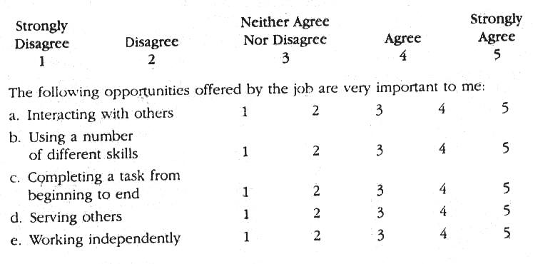
Scales (contd..)
Example: Interval Scale

Slide 12
Scales (contd..)
Ratio Scale
The ratio scale overcomes the disadvantages of the arbitrary origin point of the interval scale, in that it has absolute (in contrast to an arbitrary) zero point, which is a meaningful measurement point. Thus the ratio scale not only measures the magnitude of the differences between points on the scale but also taps the proportions in the differences. I is the most powerful of the four scales because it has unique zero origin (not an arbitrary origin) and subsumes all the properties of the other three scales. The weighing balance is a good example of a ration scale. It has an absolute (not an arbitrary) zero origin calibrated on it, which allows us to calculate the ratio of the weights of two individuals.

Slide 13
Use of Scales
USE OF THE NOMINAL SCALE
Nominal scale is always used for obtaining personal data such as gender or department in which one works, where grouping of individuals or objects is useful, as shown below.
1.Your gender 2.Your department
- Male -Production
- Female -Sales
-Accounting
-Finance
-Personnel
-R & D
-Other (specify)

Slide 14
Use of Scales (contd..)
USE OF ORDINAL SCALE
Ordinal scale is used to rank the preferences or usage of various brands of a product by individuals and to rank order individuals, objects, or events , as per the example below.
1.Rank the following personal computers with respect to their usage in your office, assigning the number 1 to the most used system, 2 to the next most used and so on. If a particular system is not used at all in your office, put a 0 next to it.
-Apple -HP
-Compaq -IBM
-Comp USA -Packard Bell
-Dell Computer -Sony
-Gateway -Toshiba
-Other (specify)

Slide 15
Use of Scales (contd..)
USE OF INTERVAL SCALE
Interval scale is used when responses to various items that measure a variable can be tapped on a five-point (any other number of points) scale, which can thereafter be summated across the items. Below is example of Likert scale.
Using the scale below please indicate your response to each of the items that follow, by circling the number that best describes your feeling.
My job offers me a chance 1 2 3 4 5
to test myself and my abilities
Mastering this job meant a lot to me 1 2 3 4 5
Doing this job well is a reward in itself 1 2 3 4 5
Considering the time spent on the job, 1 2 3 4 5
I feel thoroughly familiar with my tasks
and responsibilities.
1=Strongly disagree,2=Disagree,3=Neither agree nor disagree,4=Agree,
5= Strongly agree

Slide 16
Use of Scales (contd..)
USE OF RATIO SCALE
Ratio scales are usually used in organizational research when exact numbers on objective (as opposed to subjective) factors are called for, as in the following questions:
How many other organizations did you work for before joining this system?
Please indicate the number of children you have in each of the following categories
      Below 3 years of age
      Between 3 and 6
      over 6 years but under 12
      12 years and over
How many retail outlets do you operate?
The responses to the questions could range from 0 to any reasonable figure.

